Slide 1
Reality to Anime Video Converter with Feature Customization
Alex Tong and Isabella Zhu
Computer Systems Lab 2022-2023, Dr. Gabor

Slide 2
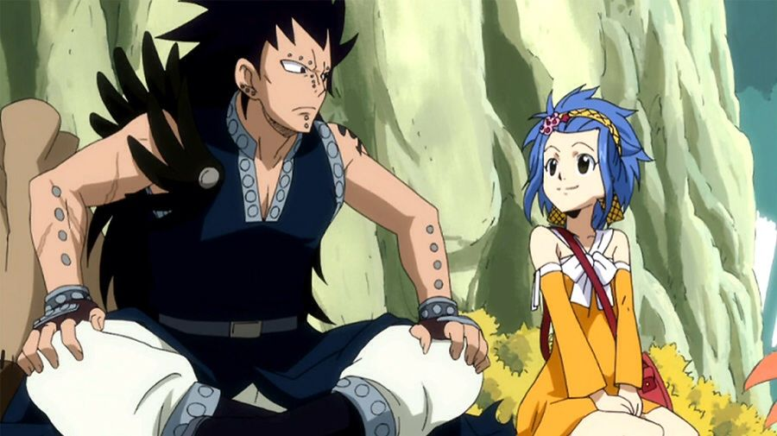
Content Overview
Objective
Cartoonization (DCT-Net)
Customization
User Interface
Notes:
Content Overview (Alex):
Our presentation consists of our objective, the cartoonization process using the Domain-Calibrated Translation network or DCT-Net library which is a library that cartoonizes images, customization of select features, and a user interface.

Slide 3
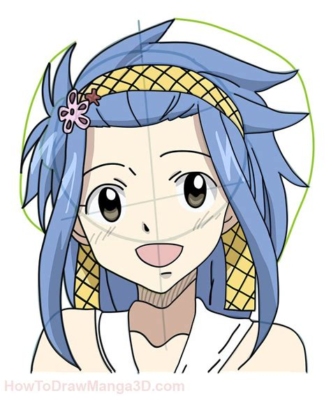
Objective
Objective
Turn real-life video into anime allowing for user customization
Allow users to submit videos of themselves to be animated
Rationale
Anime is traditionally hand-drawn, frame by frame
3000 frames per 20 minute episode, 1 hour per frame
Notes:
Objective (Alex):
Our objective was to turn a real-life video of a person into anime while allowing the user to customize the facial features by using DCT-Net and OpenCV. Anime is a popular style of Japanese animation. While there exists other software that can turn an image of a person into an anime character, they generally do not convert videos of people into anime or allow for user customization.
Users are able to submit a video of themselves to a website and customize their anime features by choosing features from a list. The website will return the customized anime video.
Anime episodes are usually about 20 minutes long. Anime artists spend thousands of hours drawing the frames for just one episode of anime. Artists could use our program to save both time and money.

Slide 4
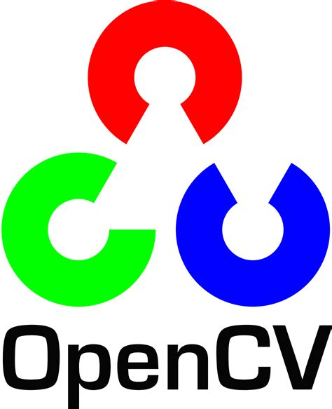
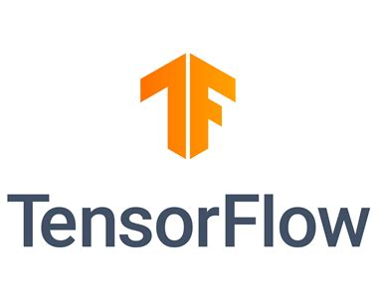
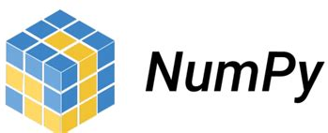




Platforms and Libraries
Python libraries
Opencv
Tensorflow
Numpy
Director
Python
Flask
HTML
JavaScript
Jupyterhub
Notes:
We primarily used python to code our project. The python libraries used are opencv for image processing, tensorflow to support downloaded machine learning models, and numpy for efficient array manipulation.
For our user interface, we created a website using TJ’s website program called Director. The Director website was created using python in flask as well as HTML and javascript.

Slide 5
Architecture
Processing
User Interface
Remote Access
Unicron GPU
TJ Director
Open-ssh client and Open-ssh keygen
JupyterHub
Notes:
Architecture:
Director allows us to display the website to the user. However, while Director does well in connecting the website to the user, it cannot run complex processes which are necessary for the program to run. In order to do our processing, this requires a supercomputer so the video needs to be transferred to that supercomputer to be processed. In this case, that supercomputer is Jupyterhub. To smoothly transfer the video from Director to Jupyterhub and back to Director after processing, we utilized secure shell libraries. The secure shell libraries used are openssh-client and ssh-keygen to remotely connect to JupyterHub from Director. While openssh-client allows us to initiate command line processes from button clicks on the website, ssh-keygen allows us to remotely connect Director to JupyterHub without authentication on the user’s part. We also used the TJ unicron server which allowed us to utilize a graphics processing unit or GPU, in order to speed up the runtime of the program. Finally, we used Python Debian version 3.8 for the configuration of the website.

Slide 6
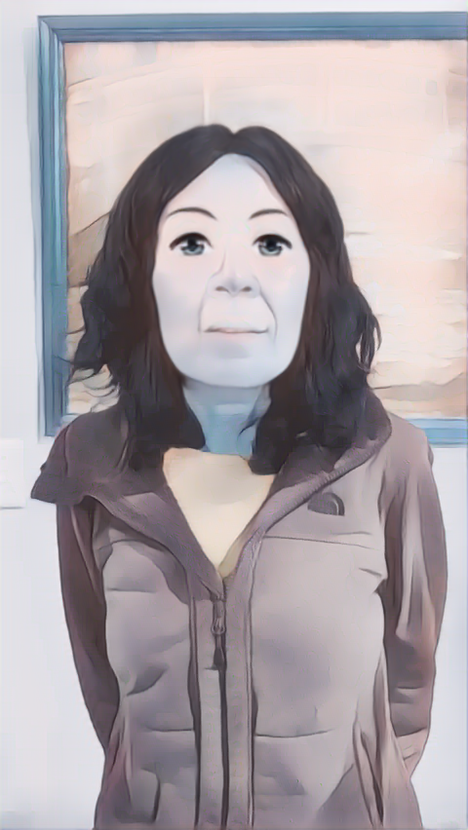
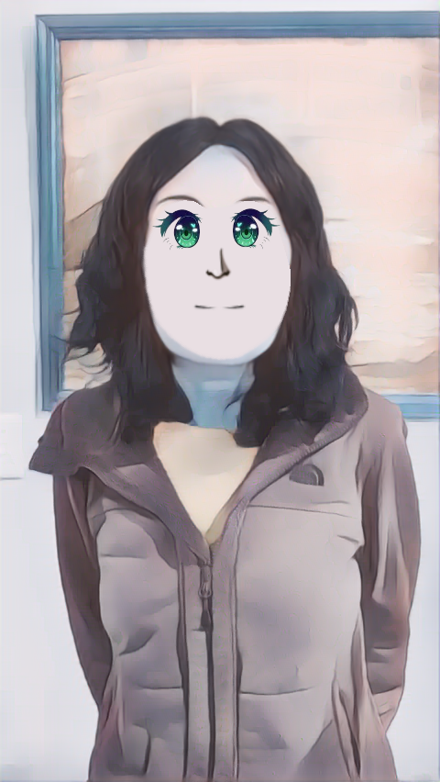
Steps of Process
User inputs video
UI initiates process in jupyterhub
DCT-Net
Customization
User downloads video
UI retrieves video from jupyterhub
Save video in jupyterhub
Notes:
Steps of Process (Isabella):
This is a flowchart for our program. The user first inputs a video of a person into our website and specifies customizations. The input video’s first frame must have the person facing forward for calibration purposes. Once the user clicks a button, the website submits the video to our project folder on JupyterHub and initiates the program.
DCT-Net, a cartoonization library was applied to each frame of the video to turn that frame into anime style. Then, the frame was modified based on the user’s customization requests.
Finally, a compilation of all the frames were combined into a finished video and sent back to the website for the user to download.

Slide 7
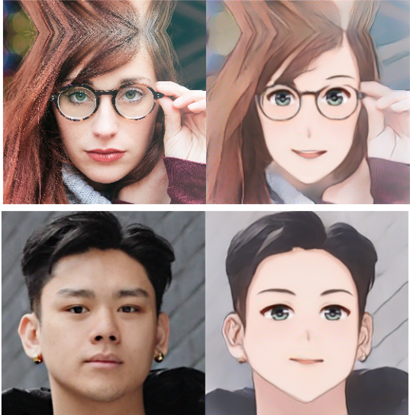
DCT-Net
Domain-calibrated translation for portrait stylization
Pre-trained model
3 modules:
Content calibration
Geometry expansion
Texture translation
Same-face syndrome
Notes:
DCT-Net is a library that we downloaded from online and incorporated into our project. It cartoonizes an image of a person using a pretrained model with three modules.
The content calibration module changes the real-life photo to be anime style. The geometry expansion module adjusts the features to be symmetrical and smooths the outlines of major shapes. The texture translation module makes minor adjustments to keep textures consistent and finalizes the cartoonization process.
DCT-Net does well in converting people to anime characters. But, it can only apply the same set of features to each person, which results in everyone looking the same after cartoonization, or in other words, same-face syndrome.
In actual anime though, anime characters often look very different from each other, with different styles of eyes, noses, etc. Thus, we modified DCT-Net in order to allow for feature customization.

Slide 8
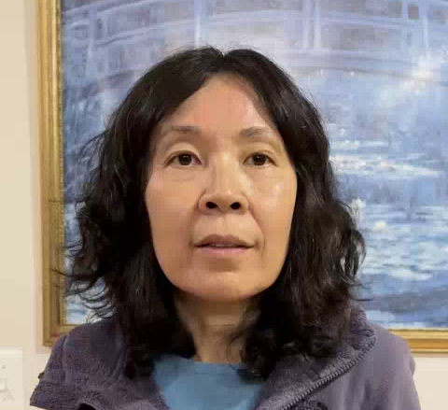
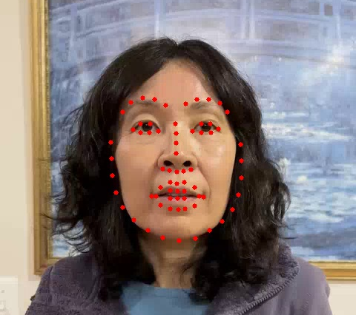
Detecting Landmarks
Marks common features of the face.
Used for scaling features later.
Notes:
Being able to map out major facial features is an important step in feature customization. We use these landmarks to locate features and measure their sizes in a quantitative way.
The pretrained model in DCT-Net detects these facial landmarks before cartoonization but doesn’t record them. We modified DCT-Net’s code to record the facial landmarks so we can use them in the customization process to calibrate.

Slide 9
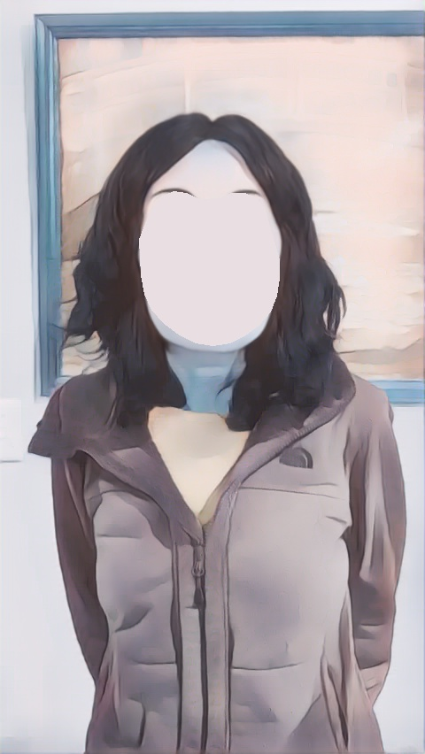

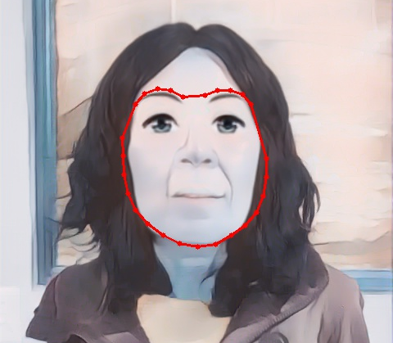
Feature Wipeout
Landmarks outlining the face form a polygon
Fill in the polygon
Apply Gaussian Blur
11 by 11 kernel
Without GB
With GB
Notes:
Our first step for feature customization is to wipe out the original features. We fill in the polygon with the facial landmarks as vertices, shown in red on the slide, to create a blank canvas for placing customized features. We chose a single representative color of the skin to fill the polygon to eliminate texture on the face, producing a 2D effect typical of anime.
Next, we apply Gaussian Blur on the polygon to reduce the harshness of the edge between the polygon and the rest of the image. Gaussian Blur is a technique that blurs edges using a matrix filter called a kernel. The larger the dimensions of the kernel, the more blurred the edge becomes. However, larger kernels also increase the runtime. We used an 11 by 11 kernel to blur the edges of the polygon.

Slide 10
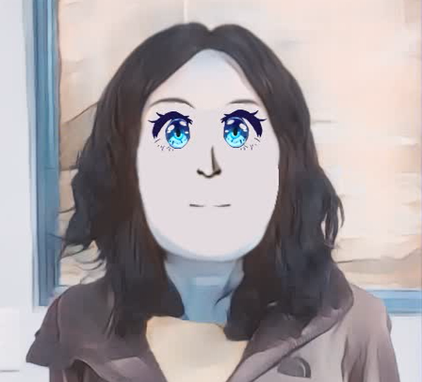
Feature Placement
Scaled based on the facial landmarks.
Overlay on top of cartoonized image.
Allows for customization.
Notes:
When the user submitted the video, the user also chose customizations from a list of feature images stored in our project folder. The next step is to place these user-chosen features on the blank face. The process of placing features on the face is essentially like putting on a sticker. We overlay the image of the feature on top of the image of the person, and we do this for every feature.
For every frame, we can calculate the height and width of each facial feature in pixels from the landmarks. For example, to calculate the width of an eye, we find the coordinates of the two corners of the eyes and subtract the x-coordinates.
We then scale the size of the feature images to be proportional to the height and width. We calculate the constants of proportionality based on the first frame of the video. This ensures that any change in the size of a feature going from frame to frame in the real-life video is accurately represented in the anime video.

Slide 11
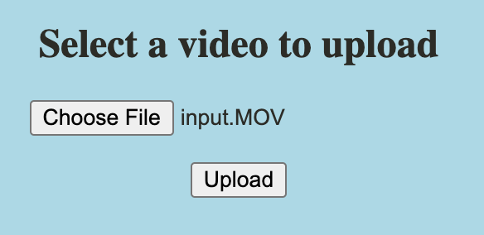
Website- User Procedures to Start Animation Process
Upload page
Notes:
Website (Alex):
For our interactive website, there are 3 pages. The first page is the upload page where the user selects their input video that they want processed. After selecting the video, the user clicks the upload button to upload the video to Director. The upload button simultaneously sends the file to Jupyterhub using ssh. It also runs an sh file which runs the program to begin processing the video.

Slide 12
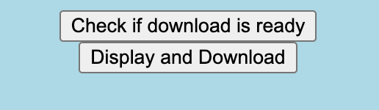
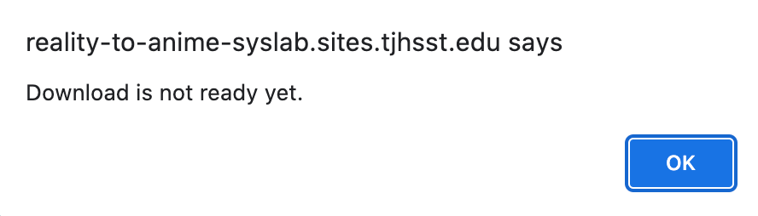
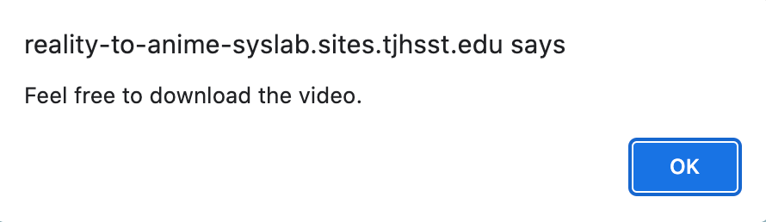
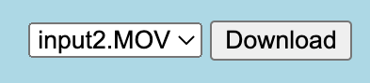
Website- Waiting and Download
Notes:
After clicking the upload button, the user is brought to a waiting page where they are able to check if their video is ready or not. When it is, they can press the download button which will take them to a download page. After being brought to the download page, the user is able to select the name of the video they want to download. This selection exists for the case that the user has submitted multiple videos to be processed.

Slide 13
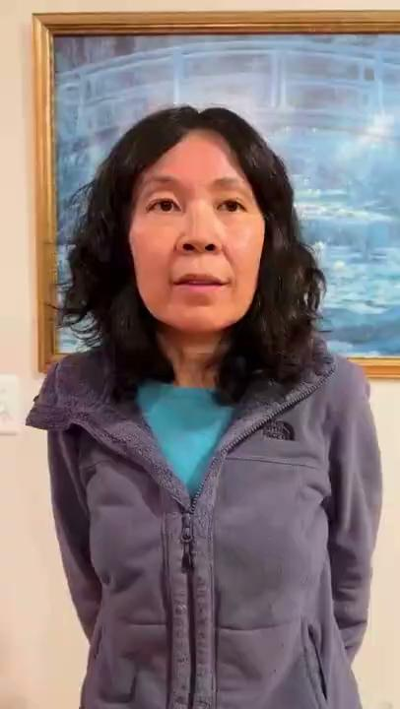
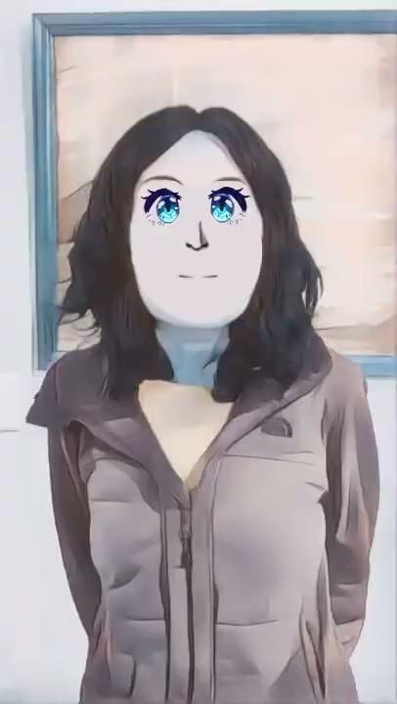
Demo
Become an anime character!
Instructions:
Face the camera with your head straight.
Turn your head slightly to the right.
Turn your head slightly to the left.
Try not to blink!
input
output
Notes:
After selecting the name of the video the user wants to download, the program begins to process the video and the output can be downloaded and viewed as shown.

Slide 14
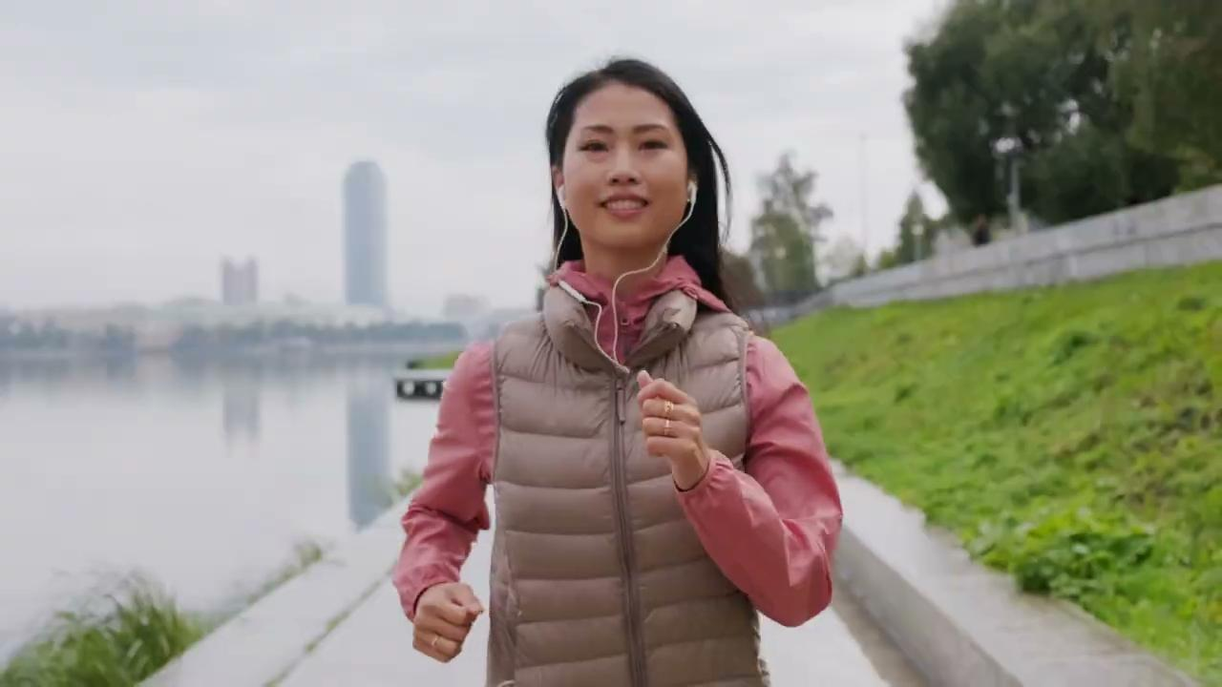
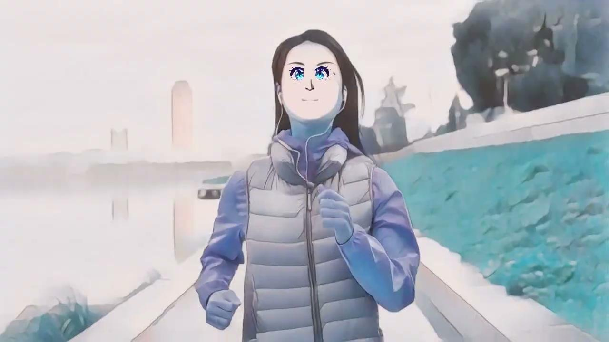
Demo
Become an anime character!
Instructions:
Face the camera with your head straight.
Turn your head slightly to the right.
Turn your head slightly to the left.
Try not to blink!
input
output
Notes:
Here is our second example which displays a scene that is more akin to an anime scene in an anime such as a slice of life anime.

Slide 15
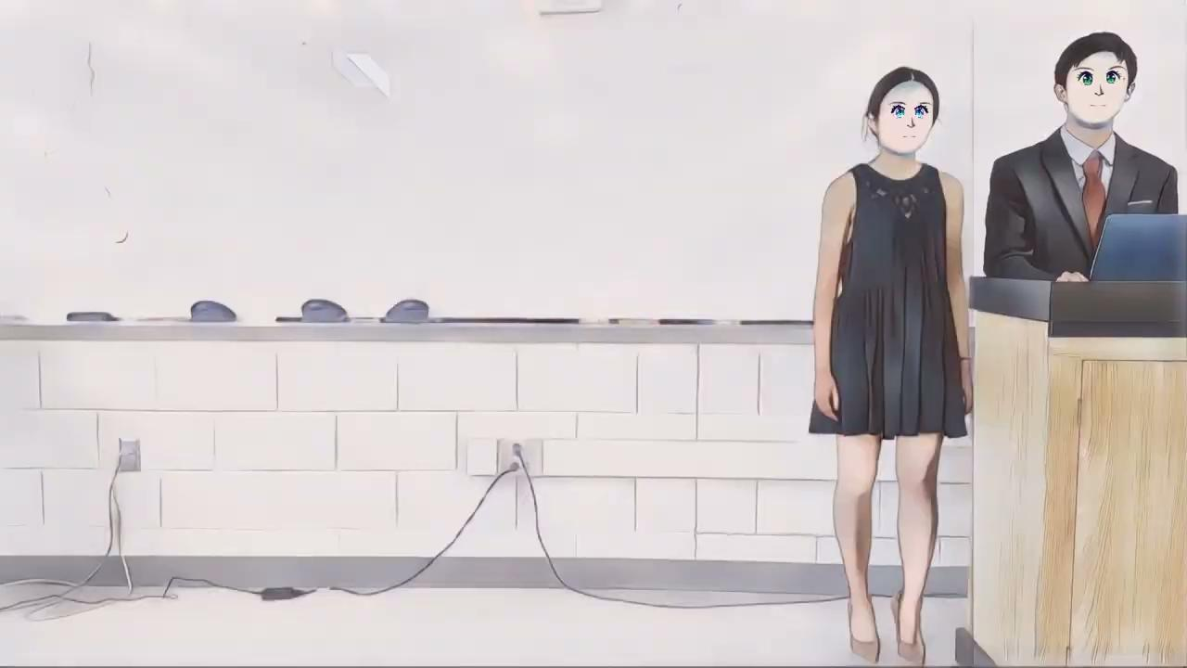
Notes:
Alex: Now it’s time to have some fun. As we explain future improvements of this project, we will be voicing over the animated video of ourselves.
Isabella: Some possibilities for future improvement include taking into account multiple people in one video. Our program only supports a video with one person in it. As a temporary solution for this, we split each frame of this video into two images and cartoonized them separately. However, this causes there to be a vertical line on the right where we split the frame. Cartoonizing and customizing multiple people in one process is more challenging because while DCT-Net can cartoonize multiple people, it does not indicate which facial landmarks correspond to which person.
Alex: Another limitation of our program is that it does not support when a person tilts their head. When a user selects a feature, it is assumed that the edges of the image are parallel to the x and y axes. This is not necessarily the case for example if the person tilts their head 15 degrees to the right. One way to fix this is to use opencv’s rotate function to rotate the image before placement.
Omit:
Finally, as you may have noticed in the output video on the previous slide, the features seem to jiggle around a bit. This is due to the variance in DCT-Net’s detection of facial landmarks. To fix this problem, we smoothed the coordinates of the landmarks using a floor function. To resolve this jiggling issue better, a more complex smoothing function could be used, perhaps by applying linear regression.

Slide 16
Future Improvements
Multiple people
Landmarks unable to indicate distinct people
Head tilting
Assumption: parallel to x and y axes
Obstacle: Tilt distorts parallel
Solution: Use OpenCV rotate function
Notes:
Alex: Now it’s time to have some fun. As we explain future improvements of this project, we will be voicing over the animated video of ourselves.
Isabella: Some possibilities for future improvement include taking into account multiple people in one video. Our program only supports a video with one person in it. As a temporary solution for this, we split each frame of this video into two images and cartoonized them separately. However, this causes there to be a vertical line on the right where we split the frame. Cartoonizing and customizing multiple people in one process is more challenging because while DCT-Net can cartoonize multiple people, it does not indicate which facial landmarks correspond to which person.
Alex: Another limitation of our program is that it does not support when a person tilts their head. When a user selects a feature, it is assumed that the edges of the image are parallel to the x and y axes. This is not necessarily the case for example if the person tilts their head 15 degrees to the right. One way to fix this is to use opencv’s rotate function to rotate the image before placement.
Omit:
Finally, as you may have noticed in the output video on the previous slide, the features seem to jiggle around a bit. This is due to the variance in DCT-Net’s detection of facial landmarks. To fix this problem, we smoothed the coordinates of the landmarks using a floor function. To resolve this jiggling issue better, a more complex smoothing function could be used, perhaps by applying linear regression.

Slide 17
References
Bradski, G. (2000). “The OpenCV Library”. In: Dr. Dobb’s Journal of Software Tools.
Harris, Charles R. et al. (Sept. 2020). “Array programming with NumPy”. In: Nature 585.7825, pp. 357–362. doi: 10.1038/s41586- 020- 2649- 2. Url: https://doi.org/10.1038/s41586-020-2649-2.
Mart ́ın Abadi et al. (2015). TensorFlow: Large-Scale Machine Learning on Heterogeneous Systems. Software available from tensorflow.org. url: https ://www.tensorflow.org/.
Men, Yifang et al. (2022). “DCT-Net: Domain-Calibrated Translation for Portrait Stylization”. In: vol. 41. 4. ACM New York, NY, USA, pp. 1–9.
Notes:
These are our references. Are there any questions?

